Slide 1


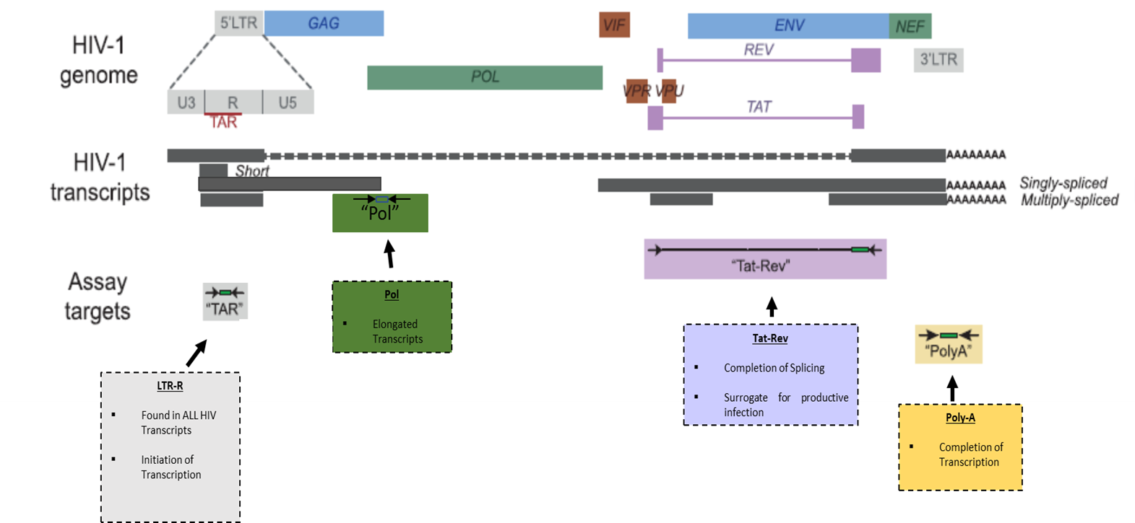
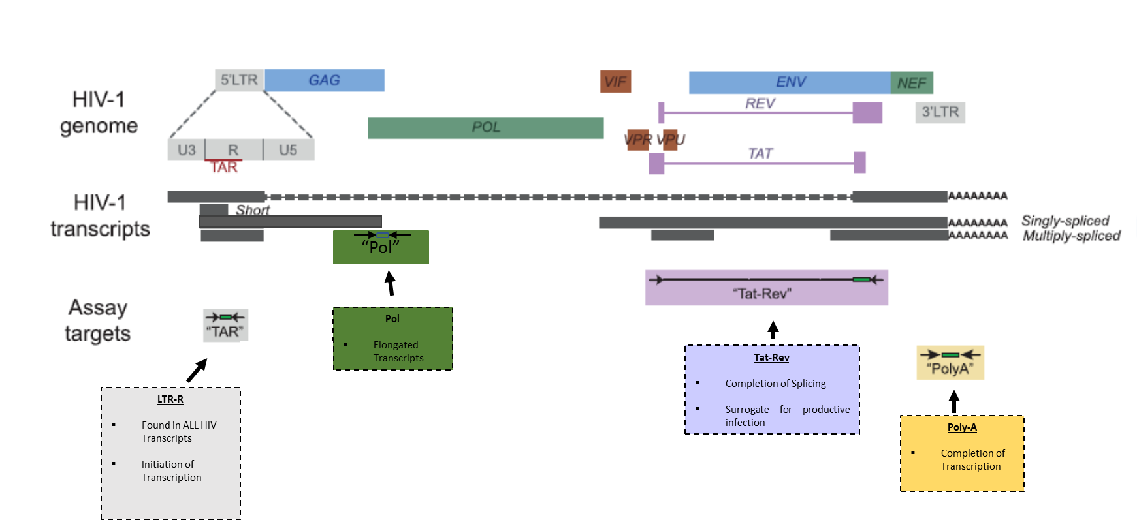
Different HIV Transcriptional Profiles in Memory CD4⁺ T Cells Subsets during ART
María Julia Ruiz, Johann Plantin, Amélie Pagliuzza, Marta Massanella,
Rémi Fromentin, Jean-Pierre Routy and Nicolas Chomont
INTRODUCTION
HIV persists in phenotypically diverse CD4⁺ T cell populations. Central memory (T_{CM}) transitional memory (T_{TM}) and effector memory (T_{EM}) CD4⁺T cells are the major cellular reservoirs for HIV. (Chomont et al, 2009, Buzon et al, 2014; Jaafoura et al 2014; Hiener et al 2017)
Blocks to elongation, distal transcription/polyadenylation and multiple splicing govern transcriptional latency in total CD4⁺ T cells (Yukl S. et al 2018).
We hypothesized that different blocks contribute to transcriptional latency in distinct memory CD4⁺ T cell subsets
METHODS
Naïve, T_{CM}, T_{TM} and T_{EM} from 12 HIV⁺ virally ART-suppressed participants were sorted by flow cytometry based on their expression of CD45RA,CD45RO, CD27,CD127, CD95 and CCR7.
Sorted cells were used for the quantification of total HIV DNA by qPCR and 4 HIV RNA transcripts by RT-qPCR: LTR-R (initiation), Pol (elongation), Poly-A (completion) and Tat-Rev (splicing).
Modified from Bullen et al., 2014 Nat. Med.; Kaiser et al., 2017 J. Virol. Methods; Lenasi et al., 2008 Cell Host Microbe

Slide 2
Transcriptional Profile of Naïve, T_{CM}, T_{TM} and T_{EM} CD4⁺ T cells from virally supressed individuals ex vivo
LTR-R
(Initiation)
Pol
(Elongation)
Poly-A
(Completion)
Tat-Rev
(Multiply Spliced)
LTR-R, elongated and polyadenylated transcripts are spontaneously produced in all CD4⁺ T cell subsets.
Memory subsets cells display an increased capacity to initiate HIV transcription compared to Naïve cells.
Tat-Rev transcripts are rarely detected.
Pol/LTR-R
Poly-A/LTR-R
Blocks in HIV Transcription in CD4⁺T cell subsets from HIV infected individuals on ART
Elongation and completion of HIV transcription are less efficient in the more differentiated subsets

Slide 3
Evaluation of Stimulated/ Ex Vivo ratios for each transcript
LTR-R
(Initiation)
Pol
(Elongation)
Poly-A (Completion)
There is an increase in the production of LTR-R, Pol and Poly-A transcripts in all subsets.
This increment was modest for LTR-R and more pronounce in the Pol and Poly-A transcripts and particularly the more differentiated subsets.
CONCLUSIONS
HIV transcripts (LTR-R, Pol and Poly-A) are spontaneously produced in Naïve, T_{CM}, T_{TM} and T_{EM} from virally suppressed individuals, while Tat- Rev transcripts are rare.
Memory subsets cells display an increased capacity to initiate HIV transcription compared to Naïve cells.
Elongation and completion of HIV transcription are less efficient in the more differentiated subsets.
Stimulation dramatically increased the levels of Pol and Poly-A, particularly in T_{EM.} cells
Our results reveal differences in the blocks of HIV transcription between different CD4⁺ T cells subsets.

Slide 4
LTR-R
(Initiation)
Pol
(Elongation)
LTR-R, elongated and polyadenylated and multiply spliced transcripts are produced in all CD4⁺ T cell subsets after stimulation.
After stimulation, memory subsets T_{EM} and T_{TM} display an increased capacity to initiate HIV transcription compared to Naive, whereas T_{CM} and T_{TM} displayed an increased capacity to elongated HIV transcription compared to Naive,.
Tat-Rev
(Multiply Spliced)
Poly-A
(Completion)

Slide 5
T_{CM}
T_{TM}
T_{E} _{M}
Naive

Slide 6
T_{CM}
T_{TM}
T_{EM}
Naive

